Slide 1
Mobile application
Registration student

Slide 2
software
Xampp (Apache + MYSQL)
Slim Framework
PDO
GIT
Node.js
Ionic + cordova
RESTful API

Slide 3
Functional and non-functional
Register new student.
Searching for student by name, lastname or student id.
Update
Delete
Showing data on page
Easy to use

Slide 4
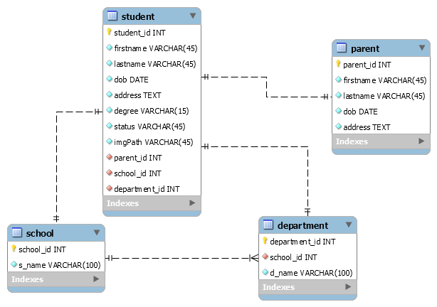
Eer diagram

Slide 5
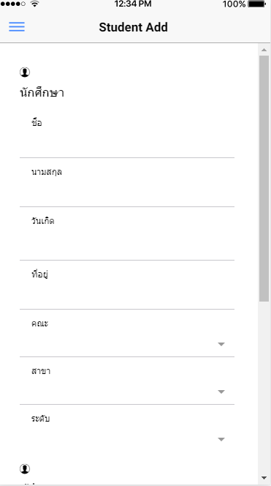
register

Slide 6
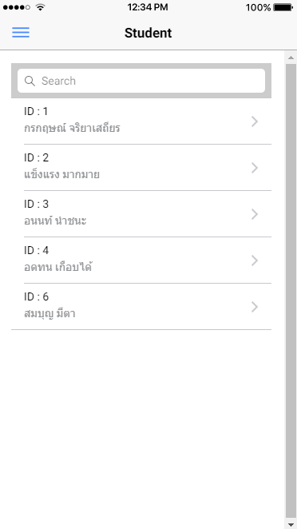
Showing data on page

Slide 7
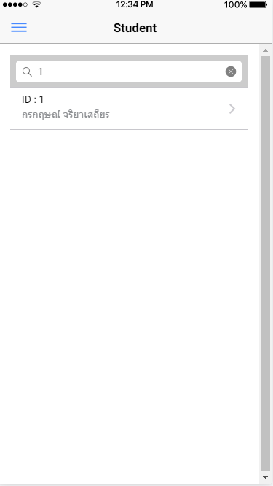
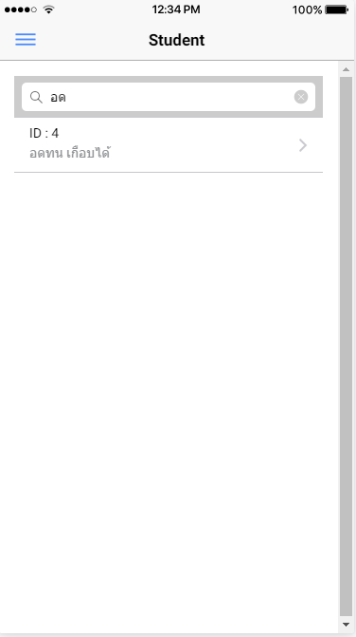
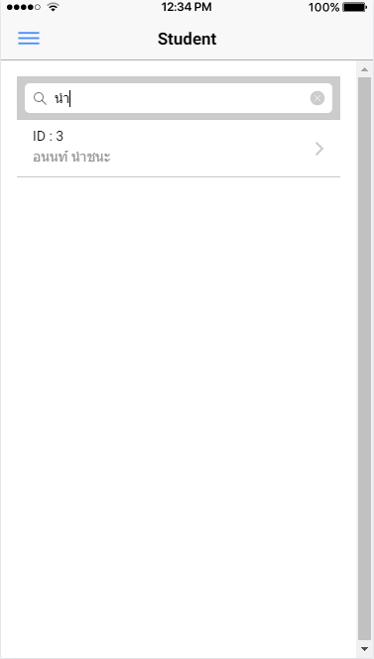
Search
By id by name by lastname

Slide 8
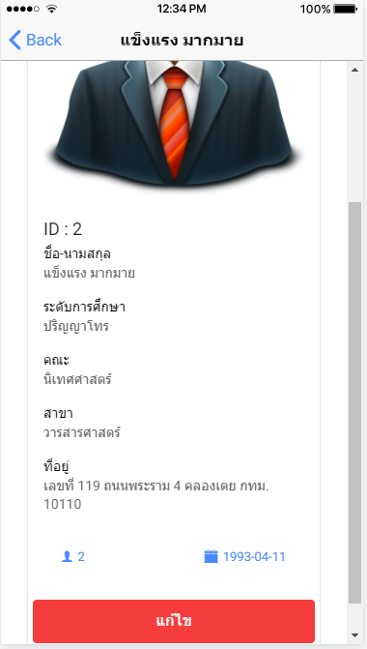
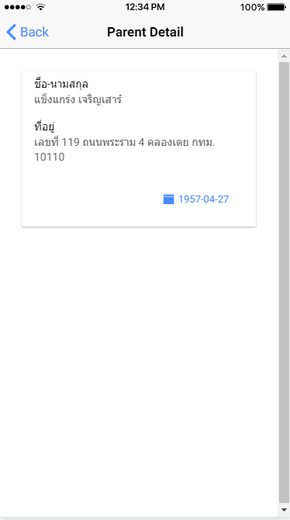
Student detail

Slide 9
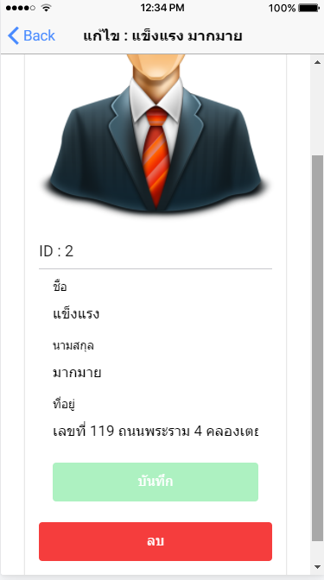
Update and delete

Slide 10
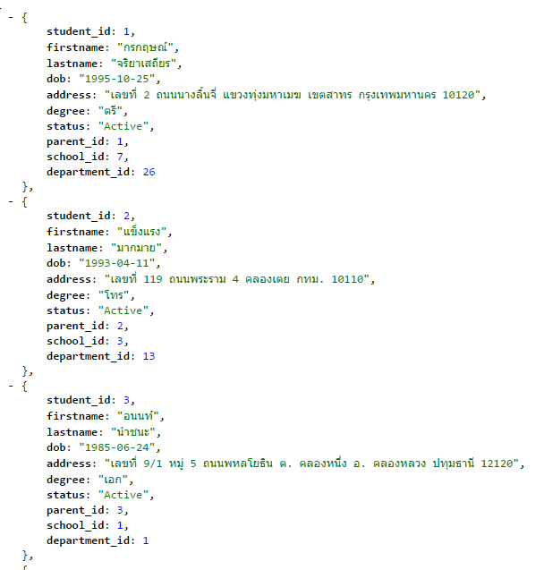
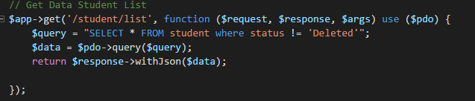
Resful api

